Slide 1

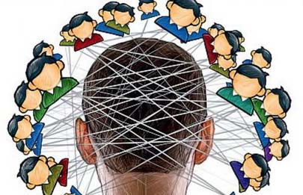

THEME: NONVERBAL COMMUNICATION
IN CROSS CULTURE
- COMMUNICATION is the act of conveying intended meanings from one entity or group to another through the use of mutually understood signs and semiotic rules.
- The word “communication” is derived from the Latin language “communicare” means “to share”.
- Communication is simply the act of transferring information from one place to another.
101 Group
Fayzullayeva Munavvar

Slide 2
Communication is a process of exchanging
Informa-tion
emotions
feelings
ideas
thoughts
through
appearance
speech
signals
behavior
writing

Slide 3
There are different categories of communication:
Spoken
Or
verbal
Visualization
Non-verbal
Written
Face to face
graphs
Body
language
Letters, e-mail
telephone
charts
gestures
Books, magazines
Radio or TV
maps
How we dress or act
The Internet
Other media
scent
Other media
logos

Slide 4
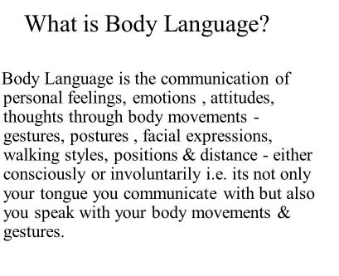

Slide 5
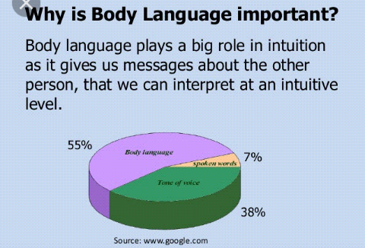

Slide 6
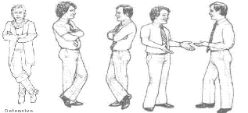
93 % communication is non-verbal:
Body language – 55%
Tone of Voice – 38%
Verbal 7%

Slide 7
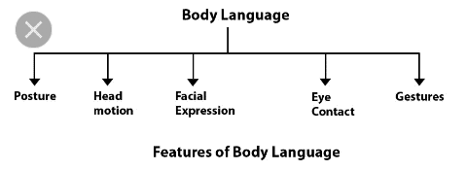
Types of Body language:
eye contact
facial expression
gestures
Posture and stance
Space relationship

Slide 8
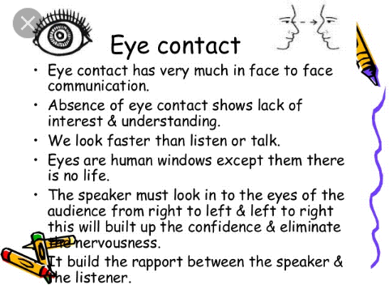

Slide 9
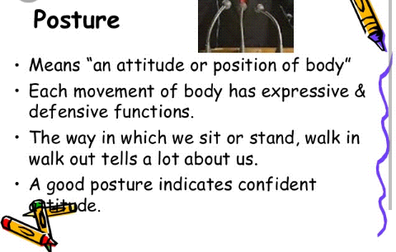

Slide 10
gestures
A Gesture is a form of non-verbal communication or non-vocal communication in which visible bodily actions communicate particular messages, either in place of, or in conjunction with, speech. Gestures include movement of the hands, face, or other parts of the body.

Slide 11

An important part of body language is your gestures, which include body movements from twitching your eyebrows, to fidgeting with your fingers. Gestures become a powerful tool of communication in the hands of an expert and sometimes, convey much more than words.

Slide 12
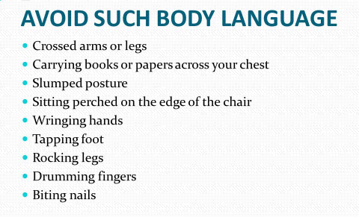

Slide 13


